Slide 1
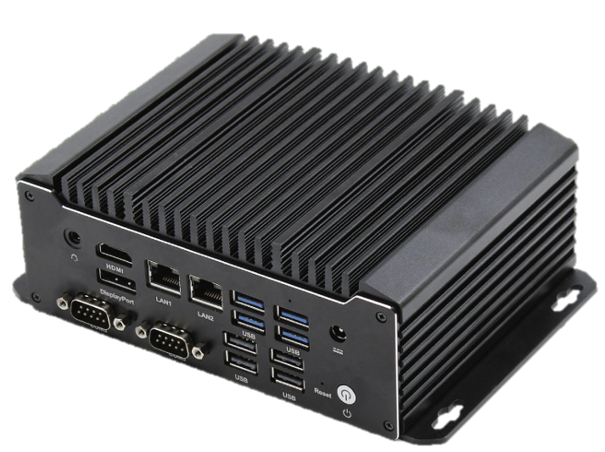
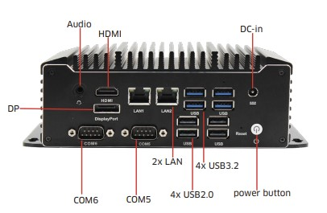
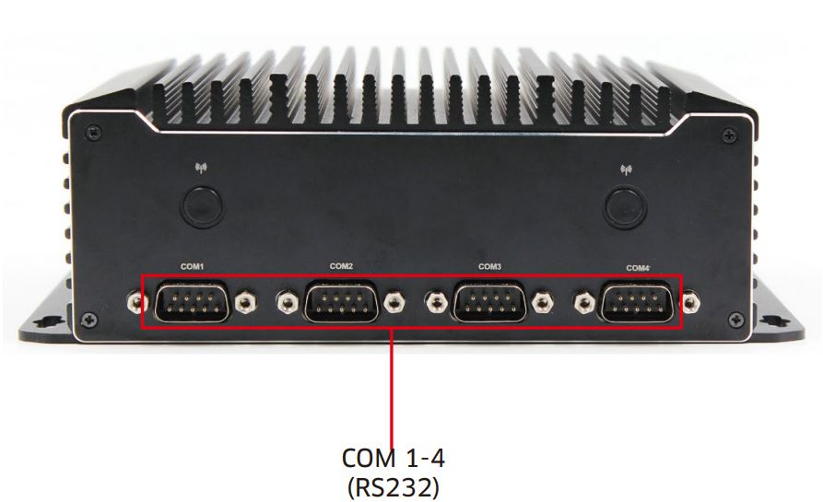
BOX PC Products
AMX-FA10000U Series
Intel® Comet Lake U based Embedded Fanless Industrial PC
BOXPC
Features
・ Intel® Comet Lake U processor ・ Dual Channel SO-DIMM DDR4 up to 32GB ・ Intel UHD Graphics, Dual displays via HDMI, DP ・ Storage: SATA3.0, 1x M.2 for 2242 SSD/4G ・ Expansion: 1x M.2 For WiFi ・ 1 x LAN Intel i210 , 1 x LAN Intel i219
SPEC
 |  | AMX-FA10110U | AMX-FA10210U
System | CPU | Intel® Core i3-10110U | Intel® Core i5-10210U
 | Max. capacity | Dual Channel 2x DDR4 2133MHz, max. 64GB
Graphic | Controller | Intel® UHD Graphics (Subject to CPU)
Ethernet | Controller | 1 x LAN Intel i210 , 1 x LAN Intel i219 Wake on LAN
Audio | Controller | Realtek HD 1x 2-in-1 Audio Jack
Storage | Device | 1 xSATA3 for 2.5' HDD or SSD
 |  | 1 x M.2 for 4G or 2242 SSD(SATA definition)
I/O Interface | RJ45 | 2x GigaLAN (Wake on LAN supported)
 | Audio | 1x 2-in-1 Audio Jack
 | USB | 4x USB3.1 Gen2 、4x USB2.0
 | Serial Ports | 4x RS232, 2x RS485
 | HDMI | 1
 | Display Port | 1
Power adaptor |  | 1*DC-IN 12V
Environmental | Operating temperature | -20C~60℃
 | Operating humidity | 10 ~ 95% RH @ 55°C (non-condensing)
Mechanical | Physical dimension | 165L x 125W x 65H mm
 | Weight (Net) | 2KG
Certification | EMI /MEC | Compliant with CE, FCC,
Support OS |  | Windows 10 (64-bit)
 |  | Linux Kernel 4.X, support Fedora 23(64Bit) &
 |  | Ubuntu 16.04 (64Bit) of Skylake-S& Kabylake-S
Dimensions
www.axcistech.com

